Slide 1

INFO6105 Final Project
Airbnb Recruiting New User Bookings Prediction
By Team Avengers

Slide 2
Project Description
Objective: Prediction the country_destination that a new airbnb user will travel to
Datasets: test_users.csv and train_users.csv contains basic information and destination of past users.
Sessions.csv contains additional web log informations generated when user use Airbnb website.

Slide 3
Overall steps
Data exploration
Load in datasets
Try two different approaches
Output predicted results

Slide 4
Data Exploration
There are missing data in `date_first_booking`, `gender`, `age` columns. So in our first approach, we applied imputation to fill and clean these features.
The `date_first_booking`: date of first booking, does not seem to be related to our study, so we dropped it.
`timestamp_first_active`: timestamp of the first activity, which could user's first visit of the website or first download of the app. We do not think it is helpful for destination contribution, so we dropped it

Slide 5
Load in datasets
Initially we mainly used train_users_2.csv & test_users.csv
Later in our 2nd approach, we extract session_feature.csv for advanced prediction

Slide 6
Two Approaches
First/Naive approach:
Random Forest Regression
Second/Advanced approach:
Additional Feature Extraction and Gradient Boosting

Slide 7
Simple Random Forest - Preprocess
Observe the dataset
Observe the missing percentage of several columns
Preprocess the dataset – fill null value & clean data
Scale the dataset
Fit model with data and train model
First model is overfit, do hyperparameter tuning
Using GridSearch to do hyperparameter tuning
Train second model use the result of GridSearch
Prediction
Details are revealed in the Notebook

Slide 8
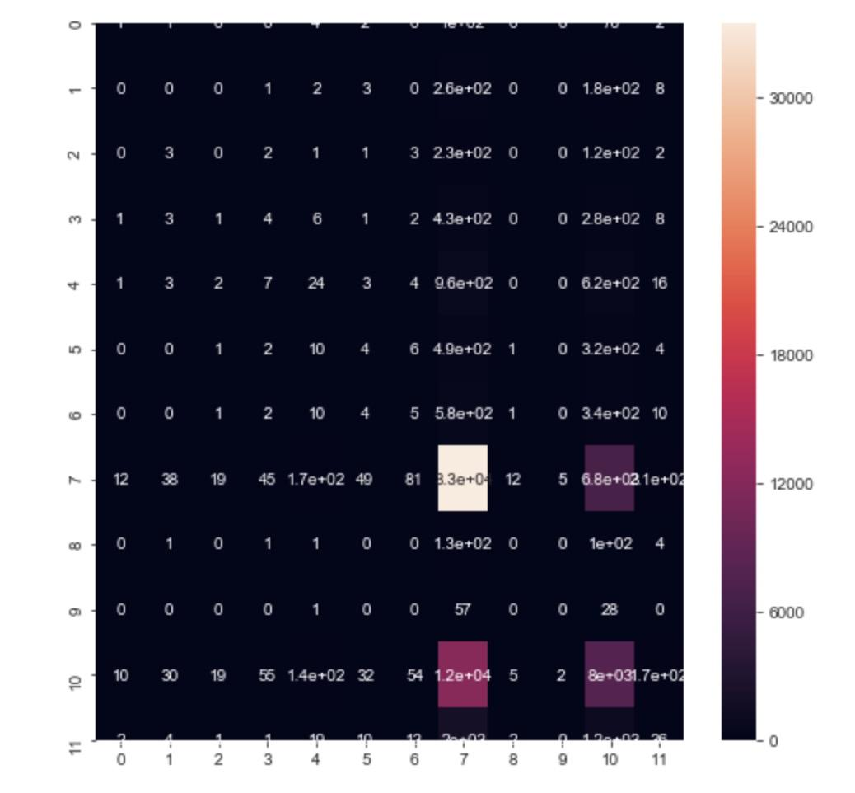
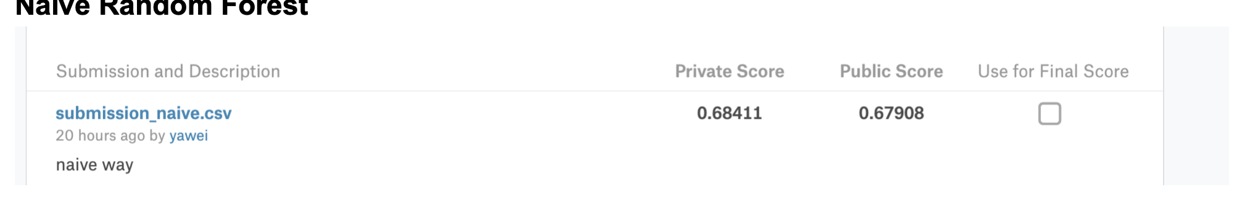
Simple Random Forest - Performance
The prediction result of our first approach is stored as submissiong_naive.csv (Note that score may varies at each runtime)
Please see the notebook for more metrics in details.

Slide 9
Advanced Approach- Thoughts
Feature Extraction & Gradient Boosting
Realizing the performance of our first approach was not ideal enough, we were motivated by other kaggle users online, to try to use sessions.csv to help our training, as it might contains useful dimensions which can help our prediction.
Also, for the learning algorithm, we did search and found XGBoost, which is an Gradient Boosting way of do the model training, might be helpful to our model build.
Therefore, we additional process to preprocess sessions.csv, statistically and selectly processed it, stored the output file as sessions_features.csv. In a later point of time, we will bring it in to help our training process.

Slide 10
Advanced Approach- Steps
Feature Extraction & Gradient Boosting
When using XGBoost, it costs relatively long time to train.
We predicted with different classifiers:
XGB trained on all (training) data
RandomForests trained on all data
XGB classifier trained on recent (aka fresh) data only
RandomForests trained on all data only.
Please see details of the training process in Notebook. ient

Slide 11
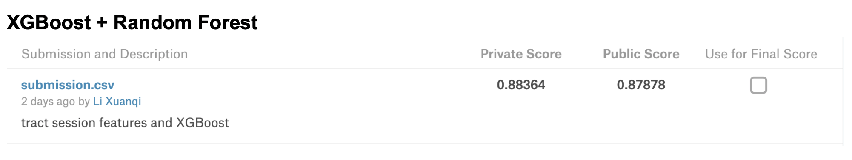
Advanced Approach- Performance
Feature Extraction & Gradient Boosting
The prediction result of our first approach is stored as submissiong.csv (Note that score may varies at each runtime)
Please see the notebook for more metrics in details.

Slide 12
What we learn from this project:
Understanding the dataset is always the most important step.
Take the objective and given dataset into consideration as a whole part, try to figure out it’s inner connection. It will guide researcher on the way of coding.
The essence is always hidden in the dataset. The more data cleaning you do, the deeper you dig into it, the better it reveals to you.
Advanced algorithm should be accelerator, but can never be generator. The power is always generated by the dataset, and the algorithm is the thing that you can empower.

Slide 13
Thanks!
Shen Wang wang.shen1@husky.neu.edu
Xuanqi Li li xuanq@husky.neu.edu
Mingjun Wang yang.mingj@husky.neu.nedu
Yawei Wang wang.yaw@husky.neu.edu

